Slide 1

Aditya Garg Amod Karambelkar Joyli Dmello Nisha Date Pratik Bhanushali Vinola Fernandes
WEB ANALYTICS Online Marketing Campaign
GetSetHome, India

Slide 2
Company Overview
GetSetHome is a service, a platform and an access to good quality shared accommodations and guesthouses.
Through its platform, GetSetHome aims to revolutionize the process of gaining access to quality shared & managed rental accommodations for long term stays.
GetSetHome is a multi-sided platform that serves two independent customer segments: the seekers (education/business/family migrators) and the owners (residential asset owners).
The entire journey for booking your home is facilitated online
Click here for a quick look

Slide 3


Facts
3
Cities
100+
Properties
600+
Tenants
90%
Occupancy
Demographics
18-34yrs
Average tenant age
55%
45%

Slide 4
Business Objectives
Increasing the Traffic on the website and the CTR through paid keywords
Increasing product awareness and measure which aspect of the business is highly searched for on Google
Brand Awareness by promoting the Facebook page and getting more likes

Slide 5
Product Features used in AdWords Campaign
Extensions
Call Extension
Sitelink Extension
Callout Extension
2. Types of Match
Broad
Phrase
Exact

Slide 6
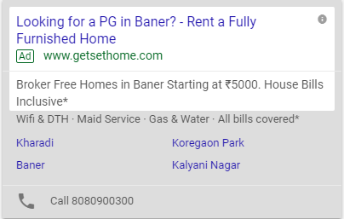
Extensions used in our Campaign
CALLOUT EXTENSION
SITELINK EXTENSION
CALL EXTENSION

Slide 7

CALL EXTENSION
Very crucial for this particular business as the first step towards a transaction is setting up a site visit through a phone call.
Impressions on mobile phones was significantly larger, which further justified our choice of using call extensions.
Ease of one click call information increases the probability of inquiry which can further be locked in as a conversion.

Slide 8
CALLOUT EXTENSIONS
Callout extensions for unique selling points.
Conceptually similar to sitelink, just without the link.
Specific to this business case, used to highlight the difference between GetSetHome and other competitors.

Slide 9
SITELINK EXTENSIONS
Sitelinks extension was used to ensure that the customers are directed to the exact location page they are looking for without having to waste time in manually applying filters.
This increases the chance of conversion (in our case, the metric we were using was a call to set up a site visit).
TYPES OF MATCH
Poorly performing keywords
Frequent changes to see whether impressions increased

Slide 10

Advertising Objective
To increase Brand Awareness among the millennials (18-35 years).
Specific characteristics of our Target Audience focuses on users who belong to one of these categories:
University Students
Housemate-based Households
Newly moved to town
Industries: IT, Health care, Management
Engaged Shoppers

Slide 11
Product Features: Facebook
Ad placement: FEEDS, INSTANT ARTICLES, IN-STREAM VIDEOS, RIGHT COLUMN
Best Ad Relevance Score: 7
Ad CPM: 3.8$
Ad CTR: 20.22%

Slide 12
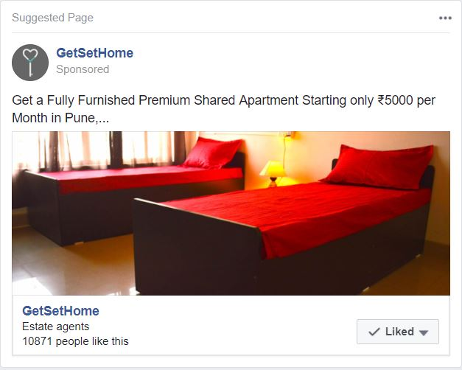
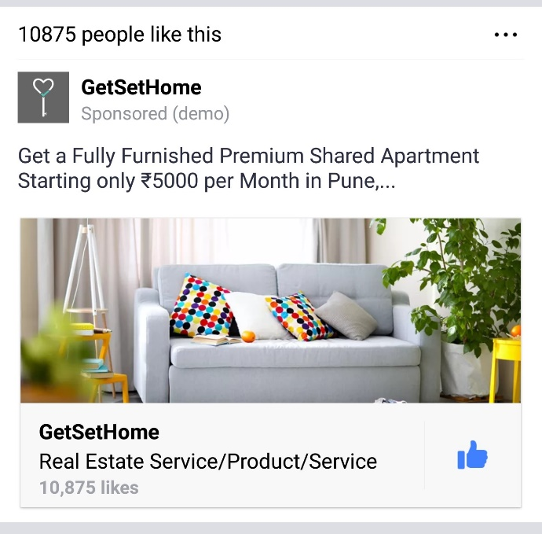
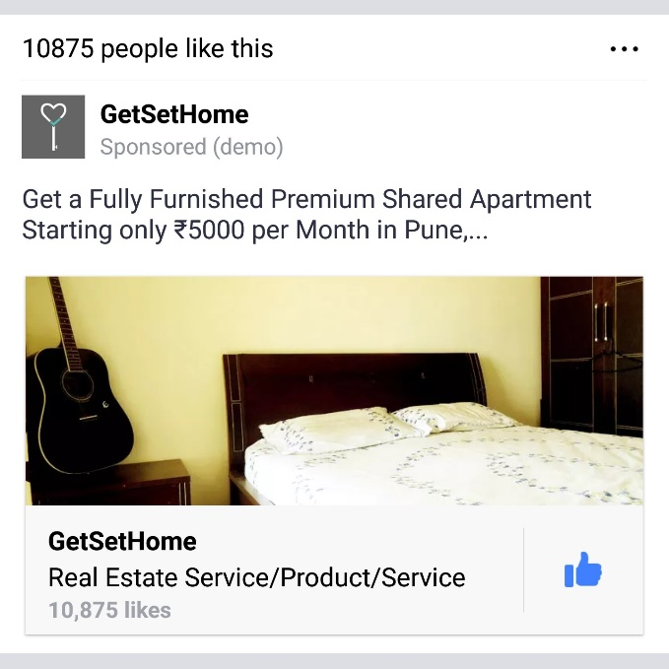
Our Ad campaign lasted for 2 weeks with a budget of 79$.
We gained approximately 4,000+ new page likes and 20,000+ impressions with a reach of 16,000+ on a average cost of 0.02$ per like during the campaign.
Sample Ad

Slide 13
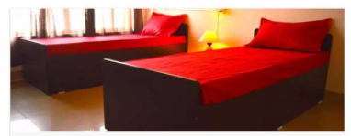

Interpretation & Reaction
Facebook Ads:
- Change in the Shutter image induced user attention and led to
increased likes.

Slide 14
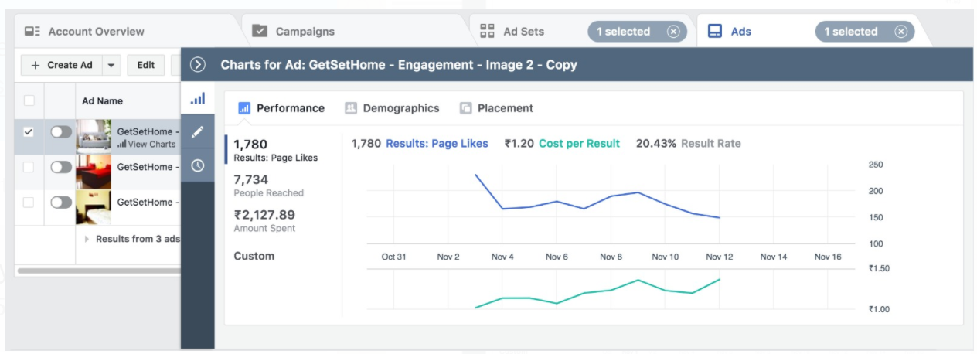
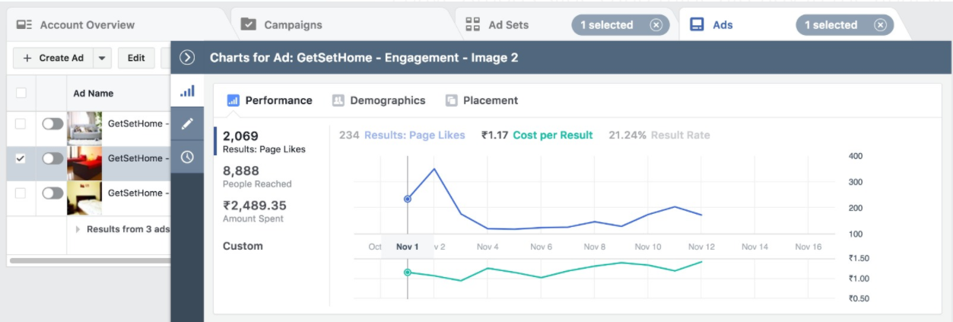
Interpretation & Reaction
Facebook Ads

Slide 15
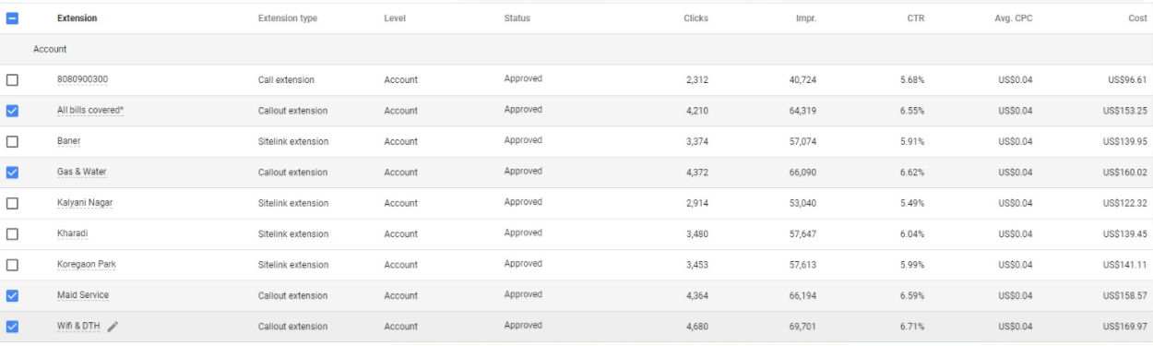
Interpretation & Reaction
Google Adwords
-Addition of Call out extension ‘Free Wifi’ , ‘Maid service increased clicks.
-Reaction : Gradually increased the budget

Slide 16
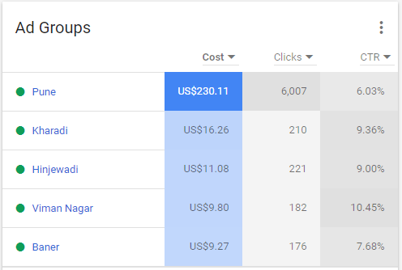
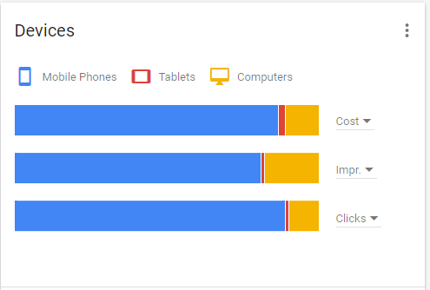
Campaign Performance

Slide 17
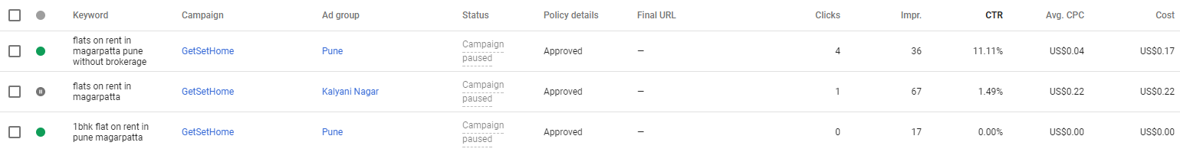
Keyword Changes & Interpretation
Keyword “flats on rent in magarpatta“ paused on 31st Oct

Slide 18
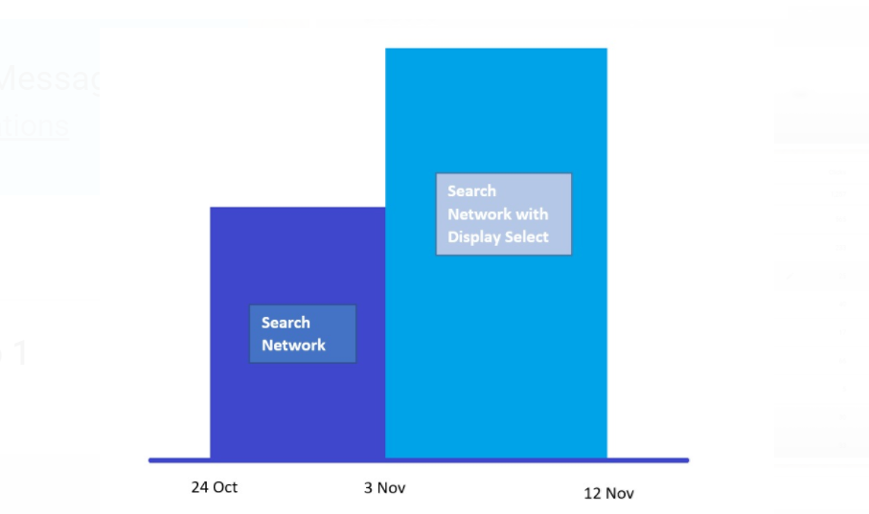
Network Changes

Slide 19
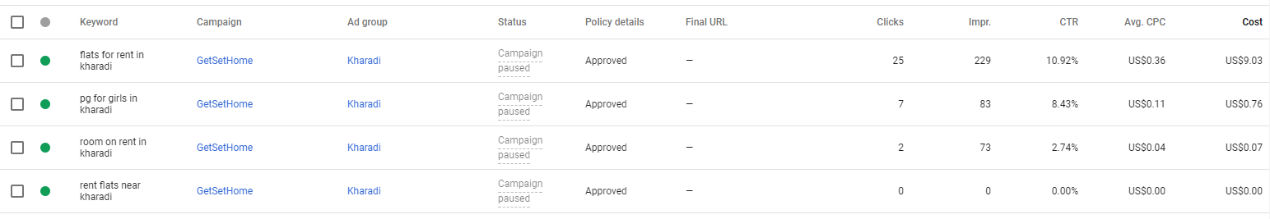
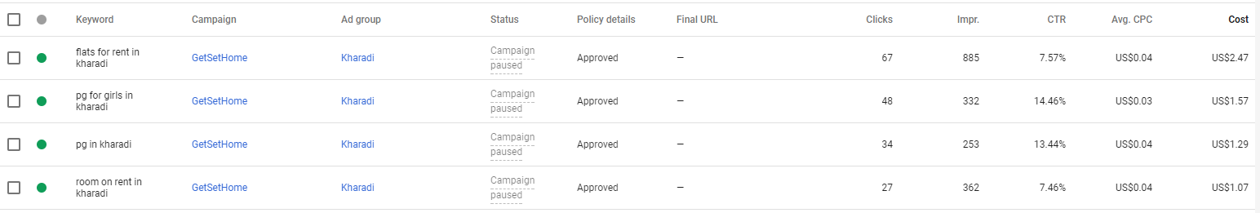
Keyword “flats for rent in kharadi”:
24 Oct – 31 Oct
1 Nov – 12 Nov

Slide 20
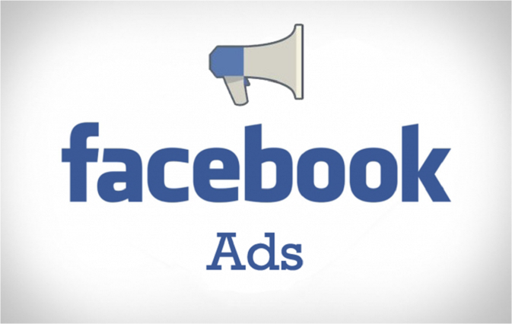

Key Differences: AdWords & Facebook
Google AdWords | Facebook Campaign
Search Intent Targeting | Specific & Powerful Targeting
Google Ads were shown to people who were searching for something specific related to Housing on Google | Facebook Ads were shown to people based on their interests in Real Estate who may or may not be aware of the company
Google AdWords were targeted to users based on limited factors like age, gender, location | Facebook enabled us to target users based on many number of factors like interests, age, sex, location, travel preference, education

Slide 21
Conclusion
For Google AdWords, the goal was to show an ad that matches exactly what people are searching and improving the Click Through Rate(CTR) & increasing traffic.
For Facebook Ads, the primary goal was to create brand awareness of the product based on user’s interests related to the product.

Slide 22
Questions?

